Slide 1


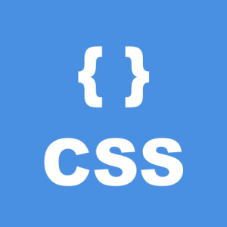
Web Development
An Introduction
By – Onkar Kulkarni

Slide 2
Who am I ?
Name : Onkar Kulkarni
Experience : More than 5 years of industrial experience.
Technologies : HTML , CSS, Java Script, C, C++ , Java and ASP.net SAP.
Hobbies : Chilling out with Friends ,Reading.

Slide 3
Todays Topics
Web development and Scope of it.
Course Content
Setting up Developer environment
HTML and its necessity.
Tags in HTML.
CSS for Web Development.
Java Script and its significance.
Examples.

Slide 4
Web Development and Scope of it
Web Development
Meaning
Basic building blocks
Scope
Types of Web Developers (Front , backend and Full Stack)
Skills Required

Slide 5
Course Content
HTML 5
CSS3
Java script
Jquery
Bootstrap

Slide 6
Setting up Development environment
A Text Editor
A web Browser

Slide 7
Starting with HTML
HTML Stands for Hyper Text Mark-up language.
Defines structure of Webpages
Uses multiple elements.
Creates a Basic Structure of Webpage or Skeleton.
Latest version : HTML 5.

Slide 8
HTML “Elements” or “Tags”
HTML Uses Elements to define structure of a report.
Elements are consist of opening tag, closing tag and data in between.
Syntax <element> Data </element>
Starting tag Actual Data Closing tag
Example : <h1 > HTML 5 </h1>

Slide 9
Structure of HTML Document
<!DOCTYPE html>
<html>
<head>
<title>
</title>
</head>
<body>
</body>
</html>

Slide 10
Tags in HTML
<!DOCTYPE html>
<html> </html>
<head> </head>
<body> </body>
<title></title>
<h1>,<h2>…<h6>

Slide 11
Starting with CSS
CSS stands for Cascading Style Sheets.
Controls the look and feel of webpage.
Controls Colour, font, Spacing of HTML element.
Advantages

Slide 12
JavaScript and Its Significance
A Web Programming Language
Most popular Programming Language
Client Side validation
Dynamic Webpages
Base for other JavaScript frameworks
Not just for Web

Slide 13
Q & A

Slide 14
Thank you !!!

